Slide 1
Sellerkart
Presentation By:
Aman Giri
Akshata Naik

Slide 2
Type of Business Models:
1. Business to Customer (B2C)- Retailer to consumer transaction
2. Business to Business (B2B)- Wholesaler to Retailer transaction
(SellerKart is B2B type)

Slide 3
Need Of the SellerKart :
In this modern era still entire business model between retailer and wholesaler are either rely on past relations they maintain or just verbal convincing approach by wholesaler which means no confirmation of delivery date and rate of product.
For not knowing different wholesalers available in the market, retailers buy products only from the wholesalers they know and end up giving high rate
Many times due to late delivery of product by wholesaler the retailer has to return their valuable customer which substandard the customer relation

Slide 4
Introduction :
This system is designed especially for large, premium and small retailer business and the local wholesalers.
E-retailer portal provide the complete functionality of placing the order from the retailer and acknowledgement from the same and getting the orders accepted from the wholesaler.
This system is going to provide ease of comparison with the price of the same product among different wholesalers and avoid the possibility of product shortage in retailer store.

Slide 5
Actors and Functions:
Admin:
Admin can delete, manage Retailer/wholesaler as per bad reviews.
Retailer:
Retailer can upload the item name and its quantity on portal and alter it any time.
Retailer can check his shops items quantity and filter out products under threshold limit which is going out of stock.
Retailer will order product to filtered out wholesaler by the portal as per rate of product.
Retailer can cancel order if order is not yet accepted by wholesaler.
Retailer can send delivery status to wholesaler when the product is arrived.
Retailer can give rating to wholesaler for every order.
Wholesaler:
Wholesaler can upload the item name and its quantity on portal and alter it any time.
Wholesaler can see list of orders requested to him by retailer to supply item.
Wholesaler will approve the request of retailer whom he wants to supply product.
Wholesaler can check if the product has delivered to retailer or not.
Wholesaler can reject order request from retailer and can give rating to retailers on every order.

Slide 6
Technology Used:
Front End: ReactJs
Back End: Java Spring Boot API.
Database: MySql

Slide 7
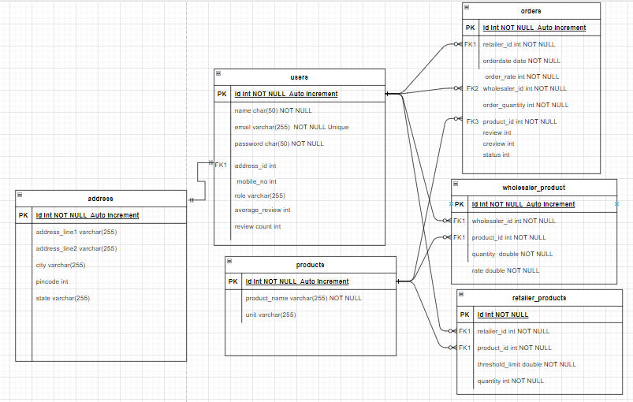
Entity Relationship Diagram

Slide 8
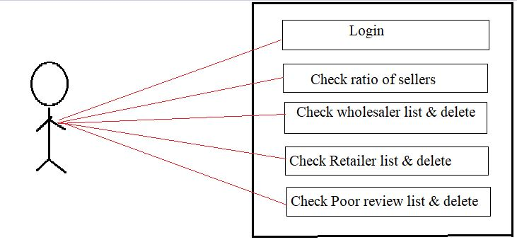
Usecase Diagrams:
Admin:

Slide 9
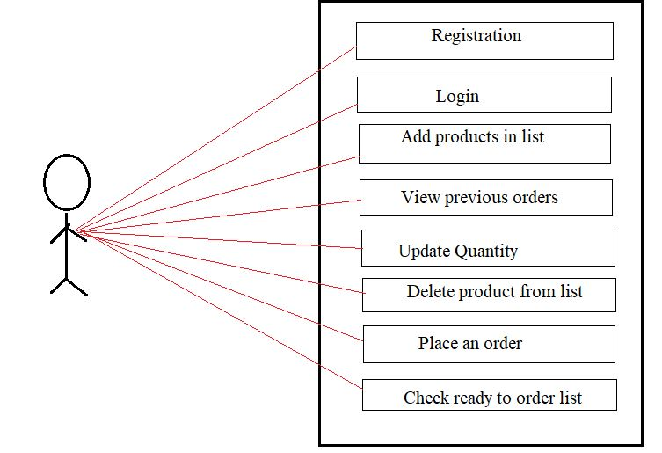
Usecase Diagrams:
Retailer:

Slide 10
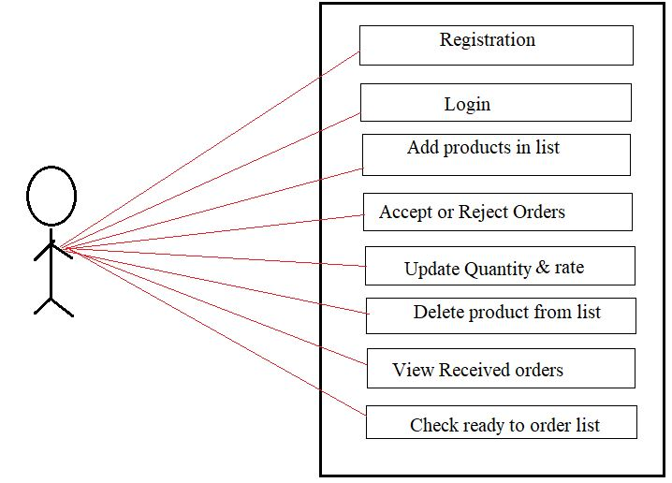
Usecase Diagrams:
Wholesaler:

Slide 11
Screenshots

Slide 12
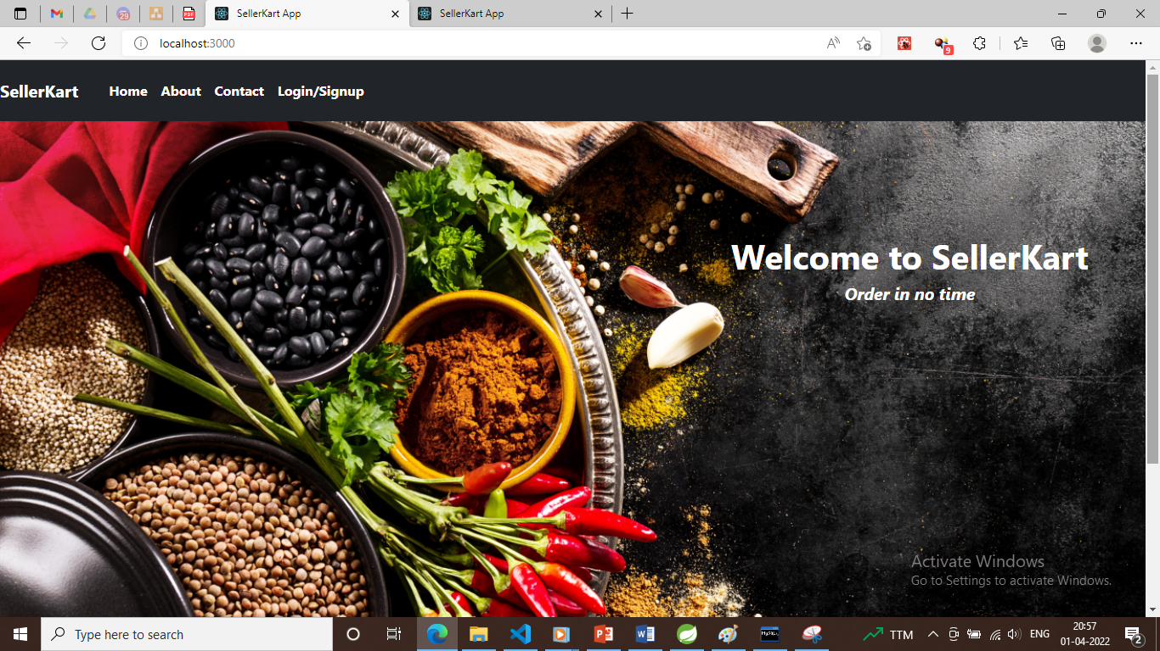

Slide 13
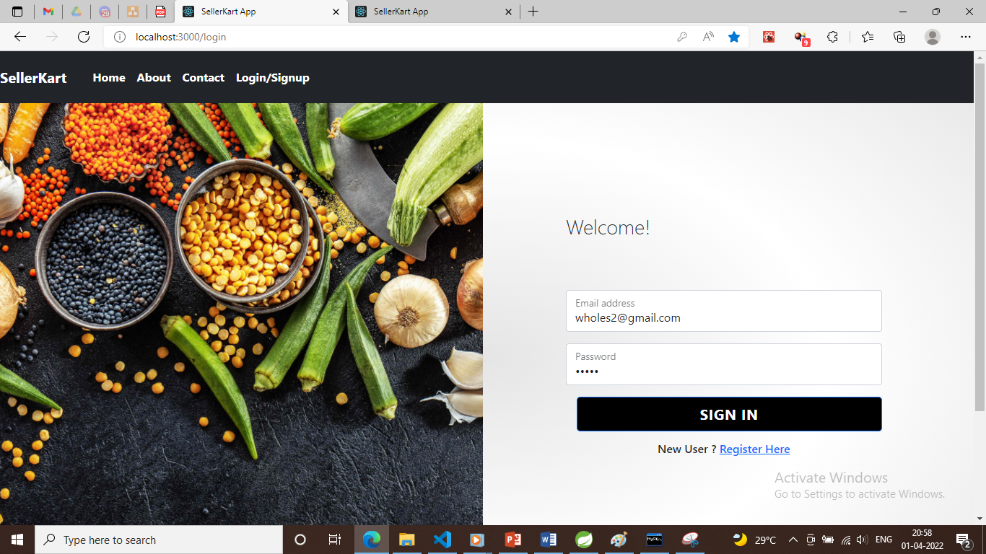

Slide 14
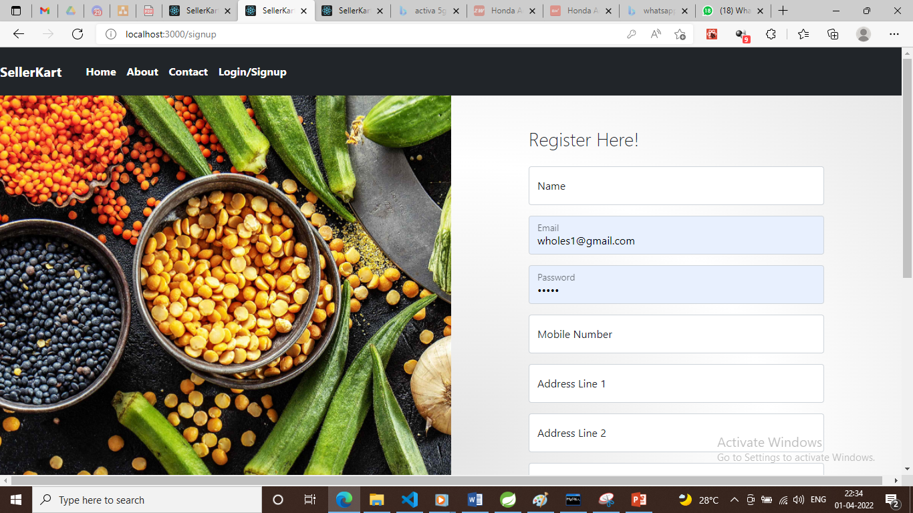

Slide 15
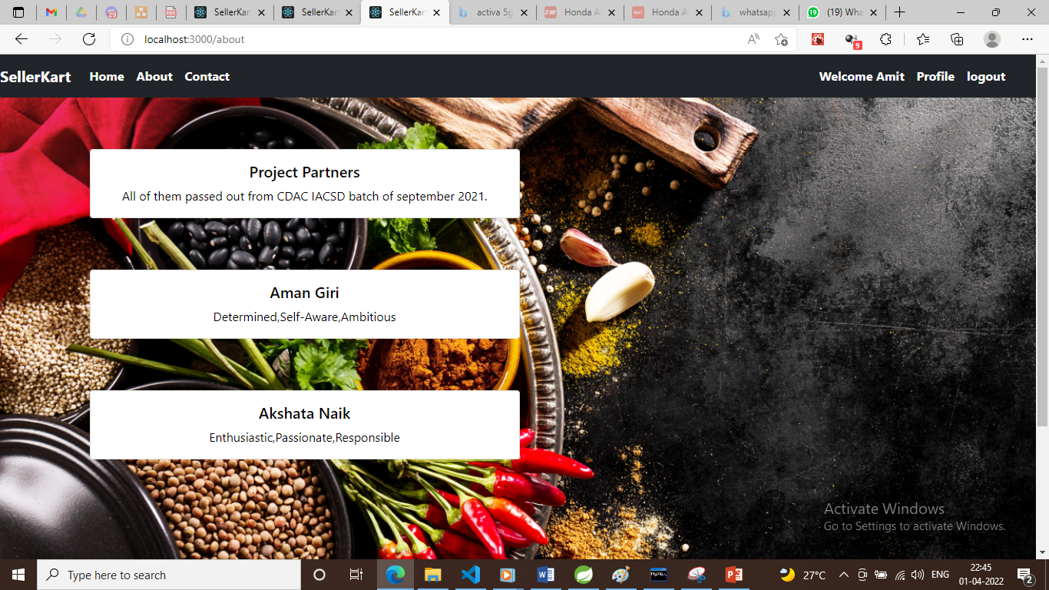

Slide 16
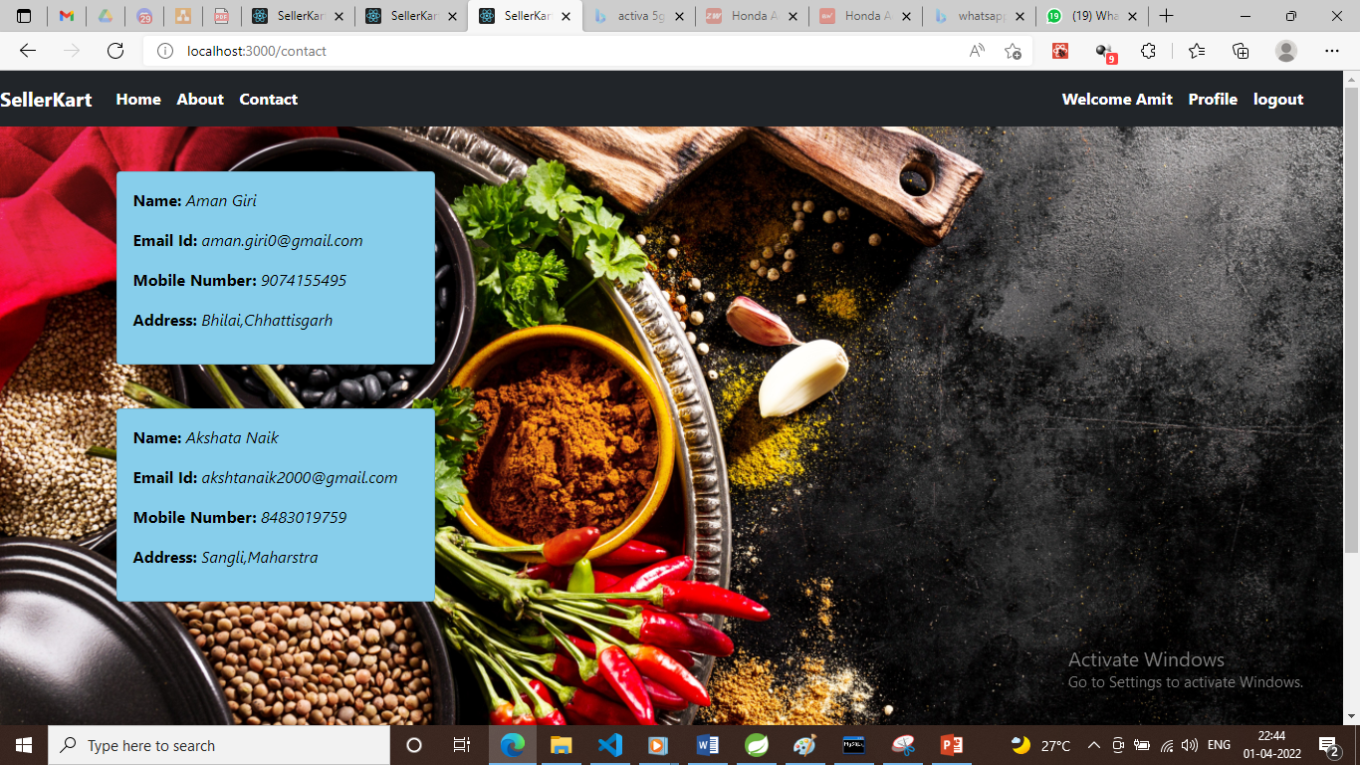

Slide 17
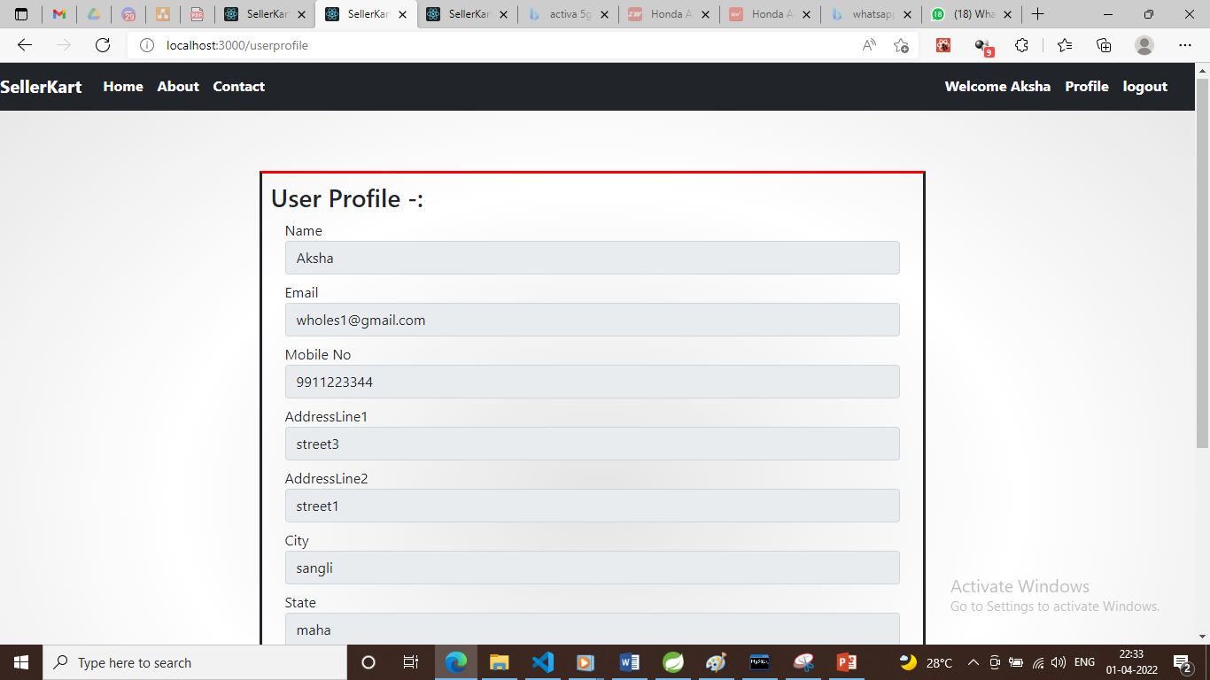

Slide 18
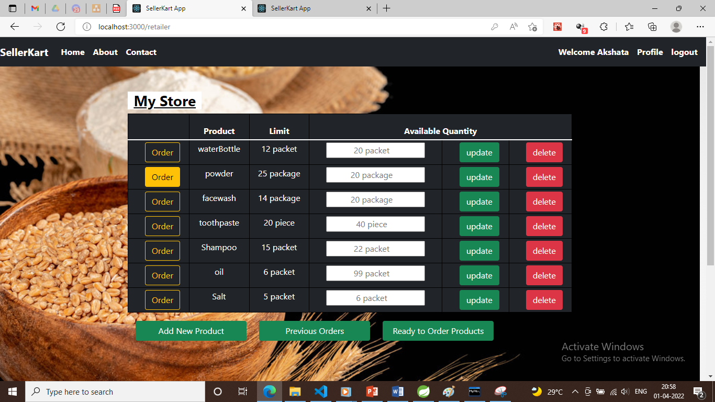

Slide 19
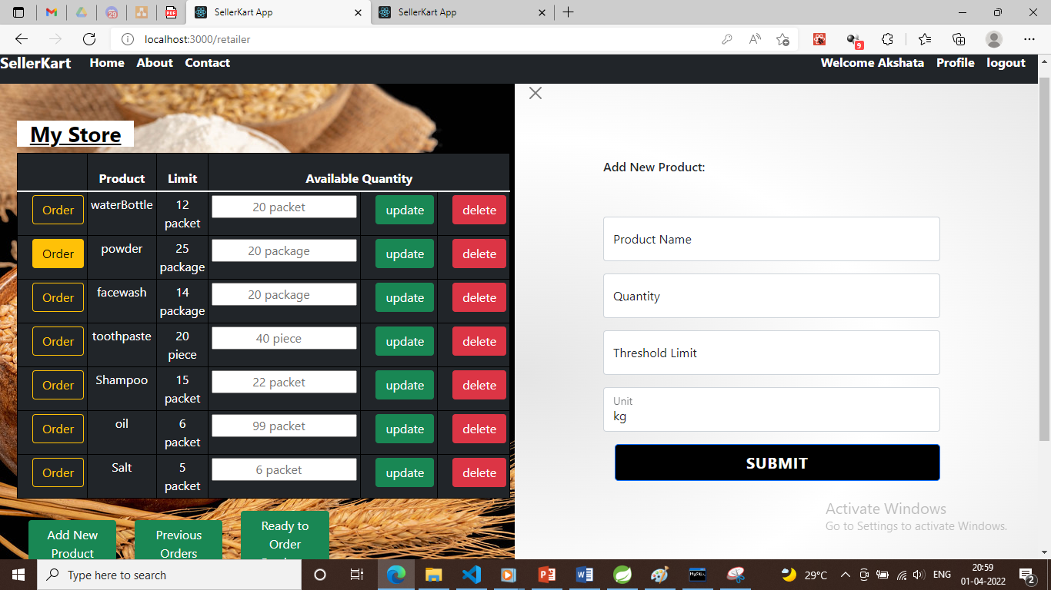

Slide 20
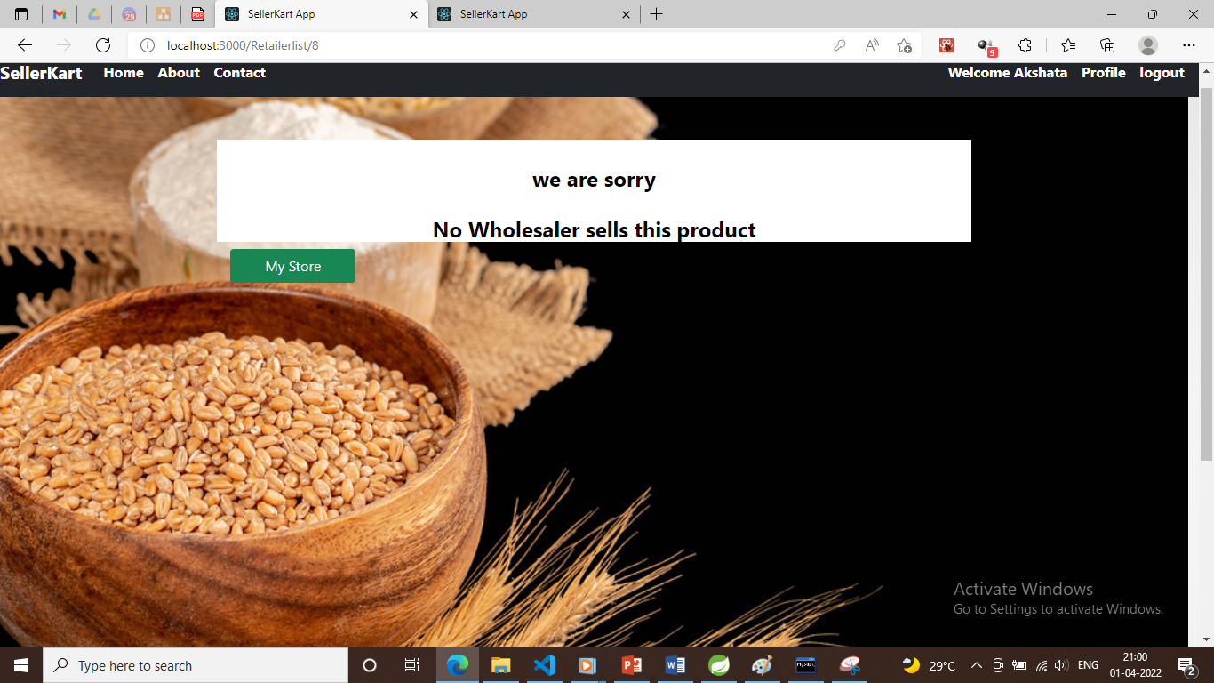

Slide 21
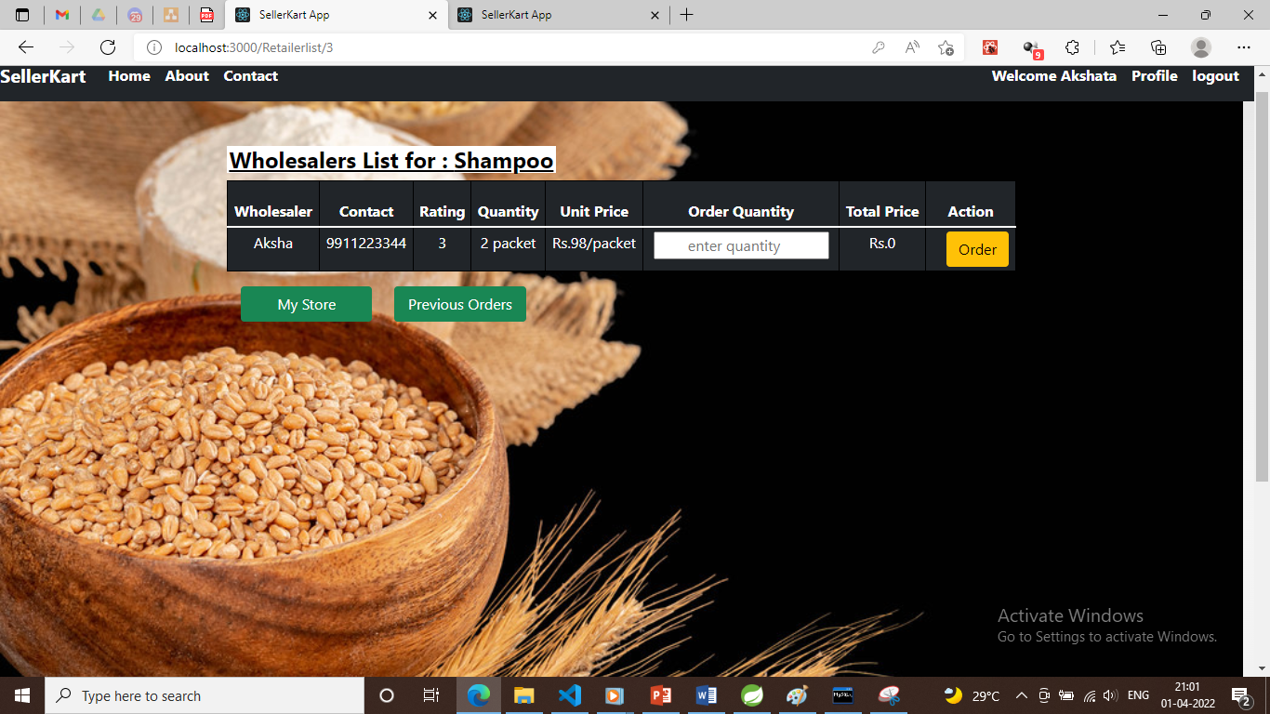

Slide 22
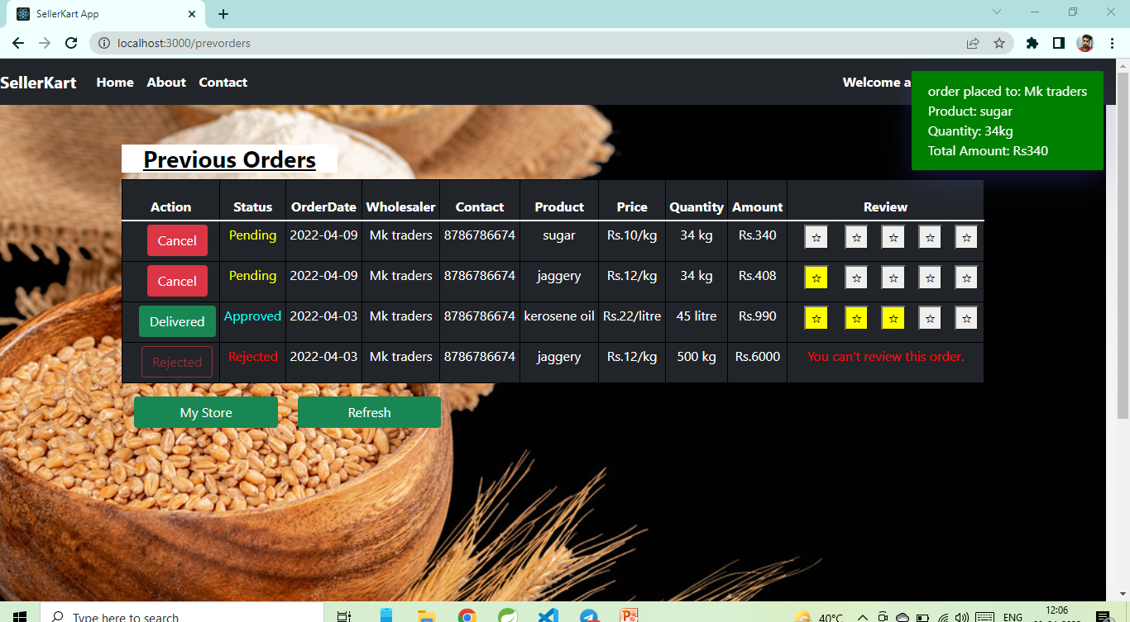

Slide 23
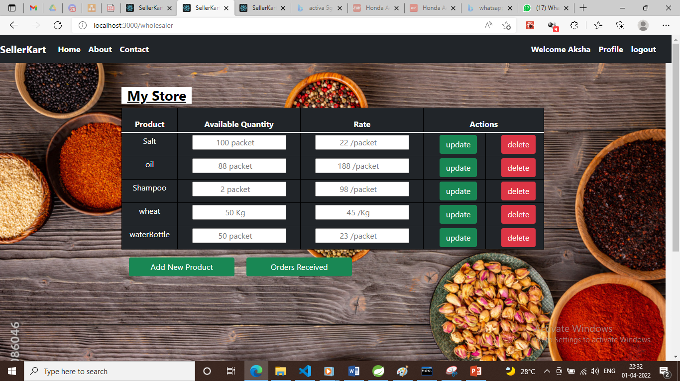

Slide 24
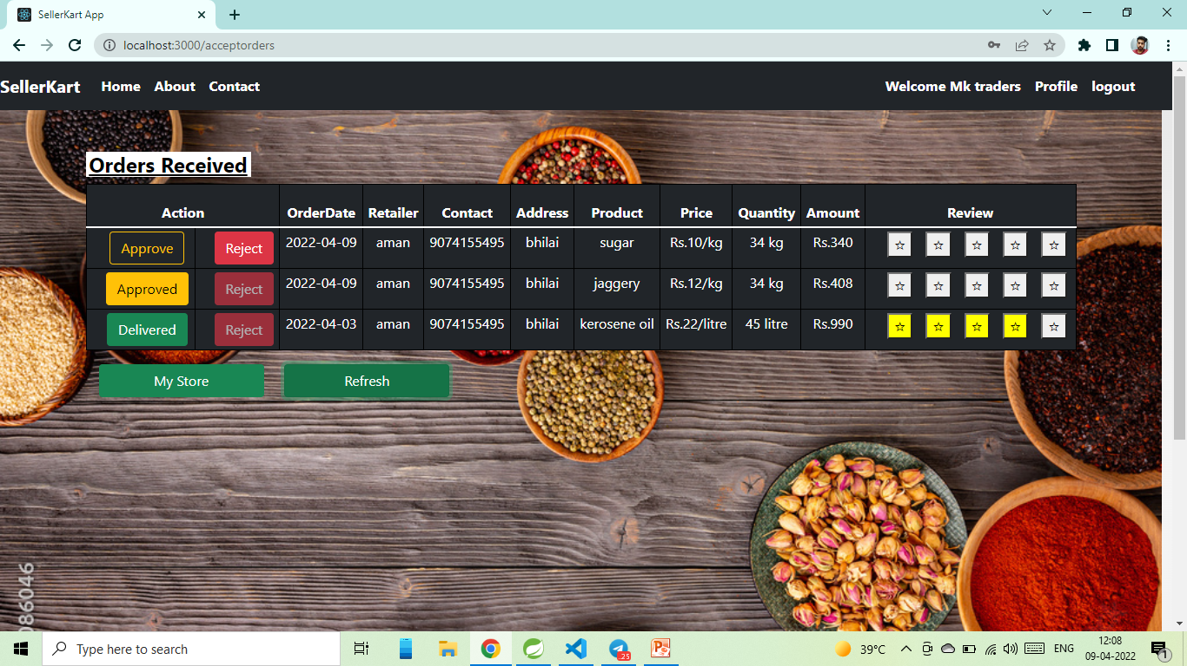

Slide 25
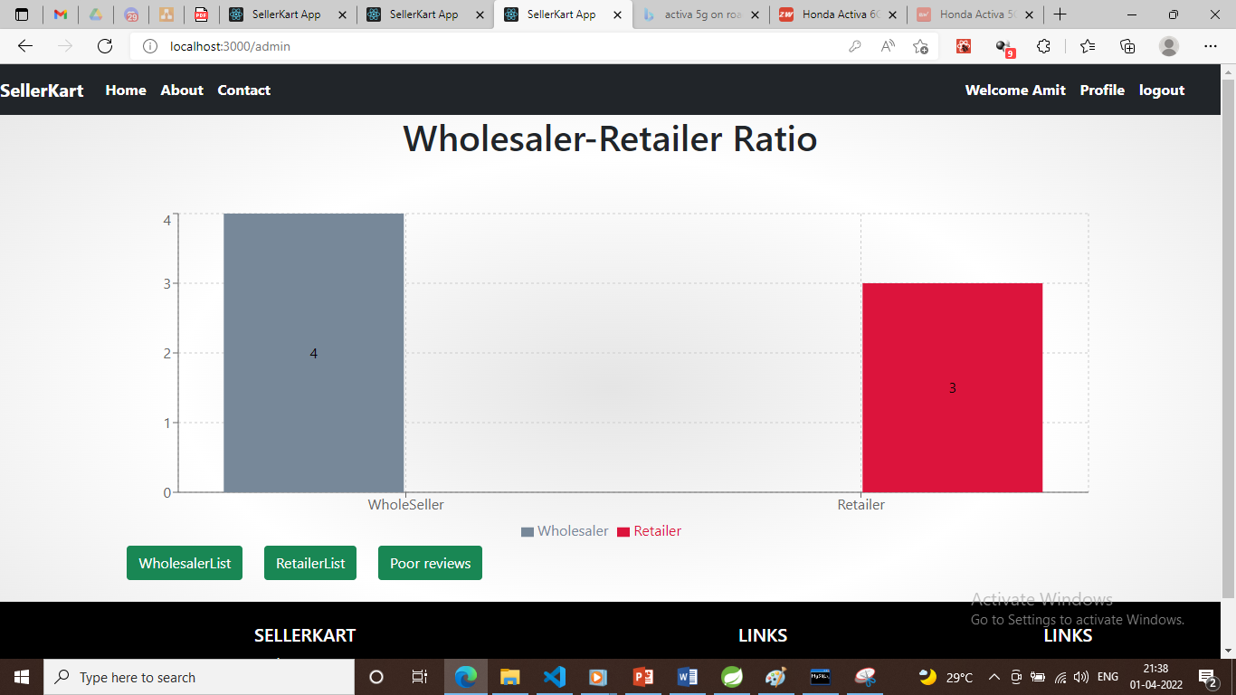

Slide 26
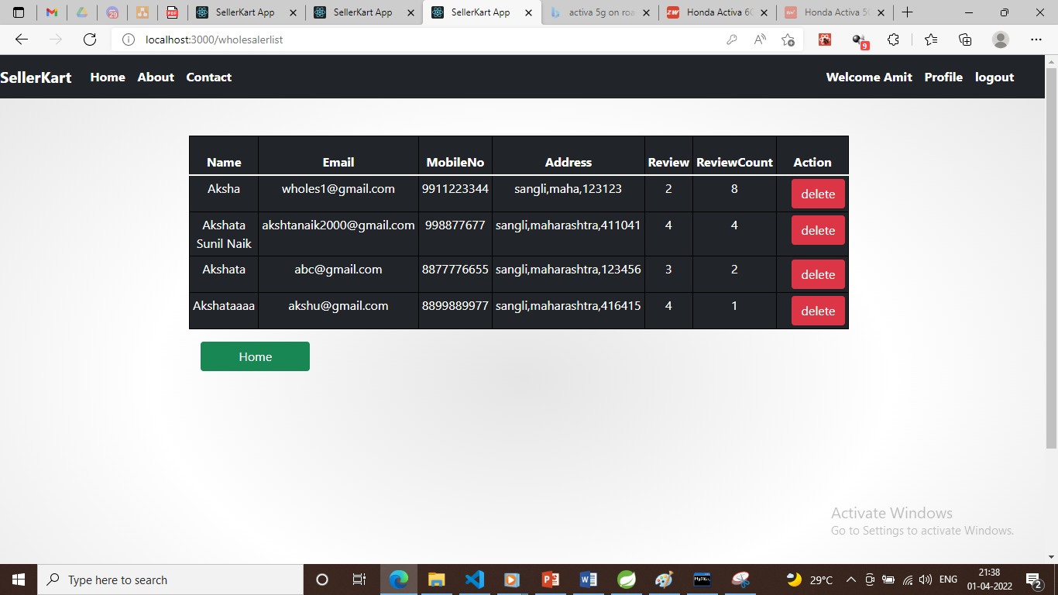

Slide 27
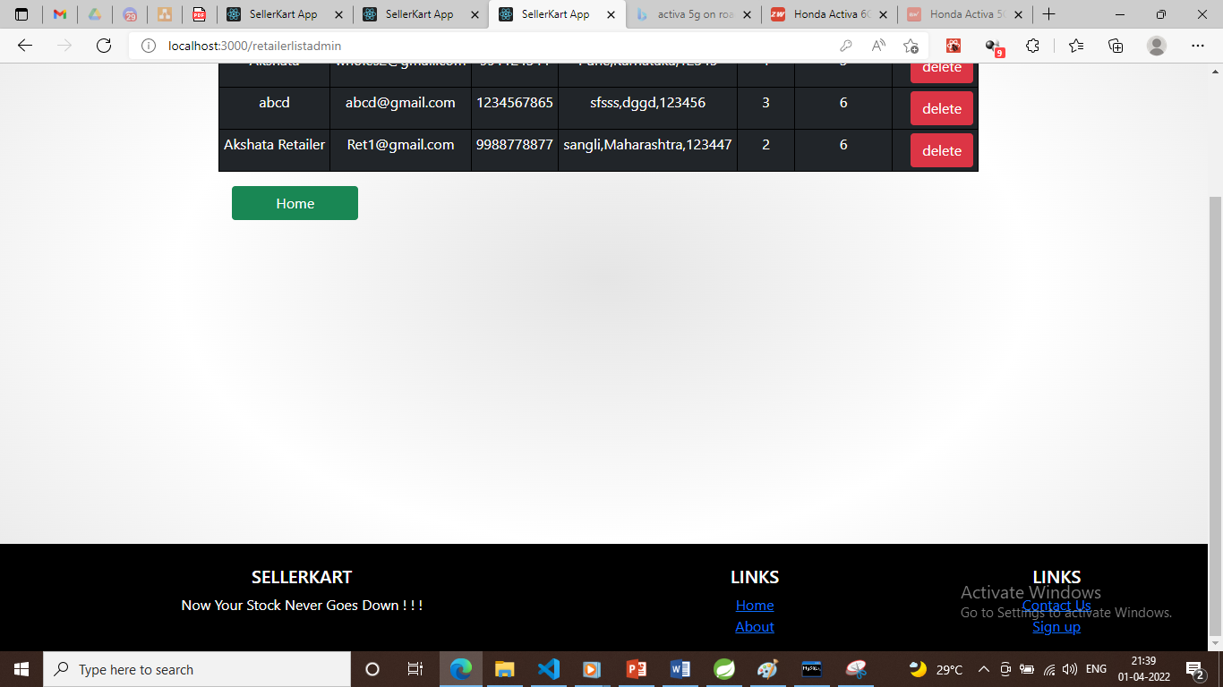

Slide 28
Thank you !

